Slide 1


LEADING THROUGH
CHANGE

Slide 2






SIX SESSIONS
Understanding Your Style
Egoless leadership
Motivating
High Performers
Effective Communication
Leading Innovation
Leading through change

Slide 3
SESSION 1

Slide 4




MODES OF
LEADERSHIP
Authoritative
Democratic
Facilitative
Situational

Slide 5
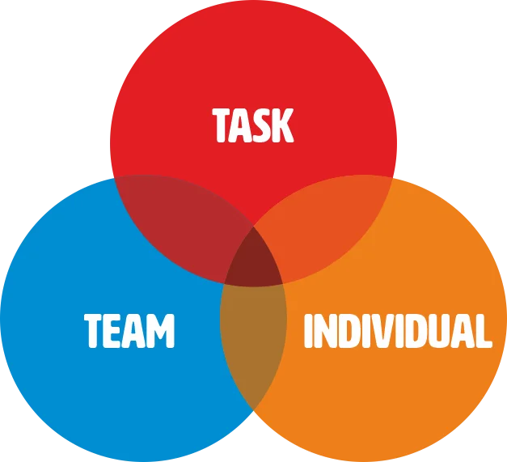
MODELS OF
LEADERSHIP
Action-centred Leadership

Slide 6
IMPLICIT
BIAS
“To make life easier, our brains make quick judgements of people and situations around us, often without realising it.”

Slide 7
SESSION 2

Slide 8
EGO VS EGOLESS
“Ego is a sense of their
worth/value . For example, if someone has a large ego, they think they are very important
and valuable”

Slide 9





EMOTIONAL
INTELLIGENCE
Self awareness
Self regulation
Motivation
Empathy
Social Skills

Slide 10
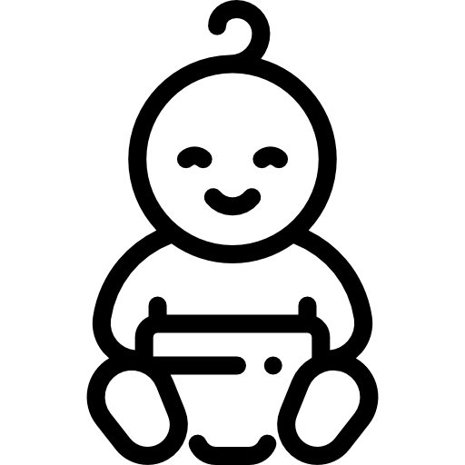




A BRIEF HISTORY
OF LEADERSHIP
Mid 1800s
Early 1900s
1950s
1970s
Leaders are born not made
Charismatic leadership
Leadership Skills
Leadership process
1980s
1940s
Transformational Leadership
Transactional Leadership

Slide 11
SESSION 3

Slide 12
A DEFINITION
Teams that “consistently satisfy the needs of customers, employees, investors and others in its area of influence” and as a result, “these teams frequently outperform other teams that produce similar products and services under similar conditions and constraints”
consistently
outperform
Ed Kur's 1996 study on high performance teams

Slide 13





FIVE FACTORS
Team Competency
Processes & Tools
Interpersonal Skills
Shared Purpose
Company Values

Slide 14

CASE STUDY

Slide 15
SESSION 4

Slide 16
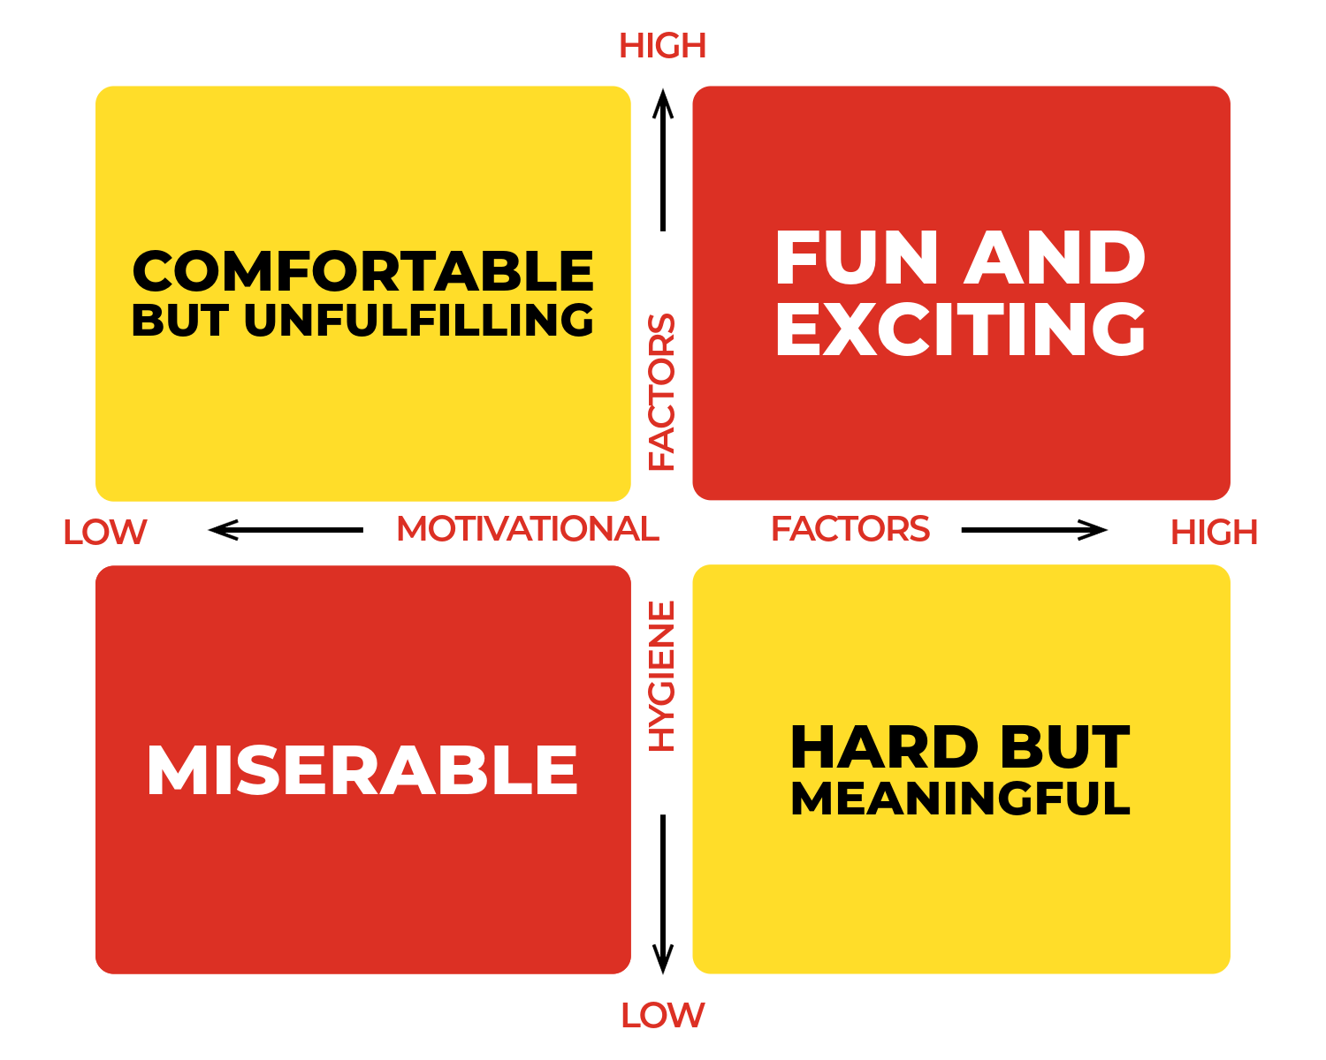

Slide 17




KEY
COMPONENTS
Learning
Effort
Challenge
Criticism

Slide 18
SESSION 5

Slide 19
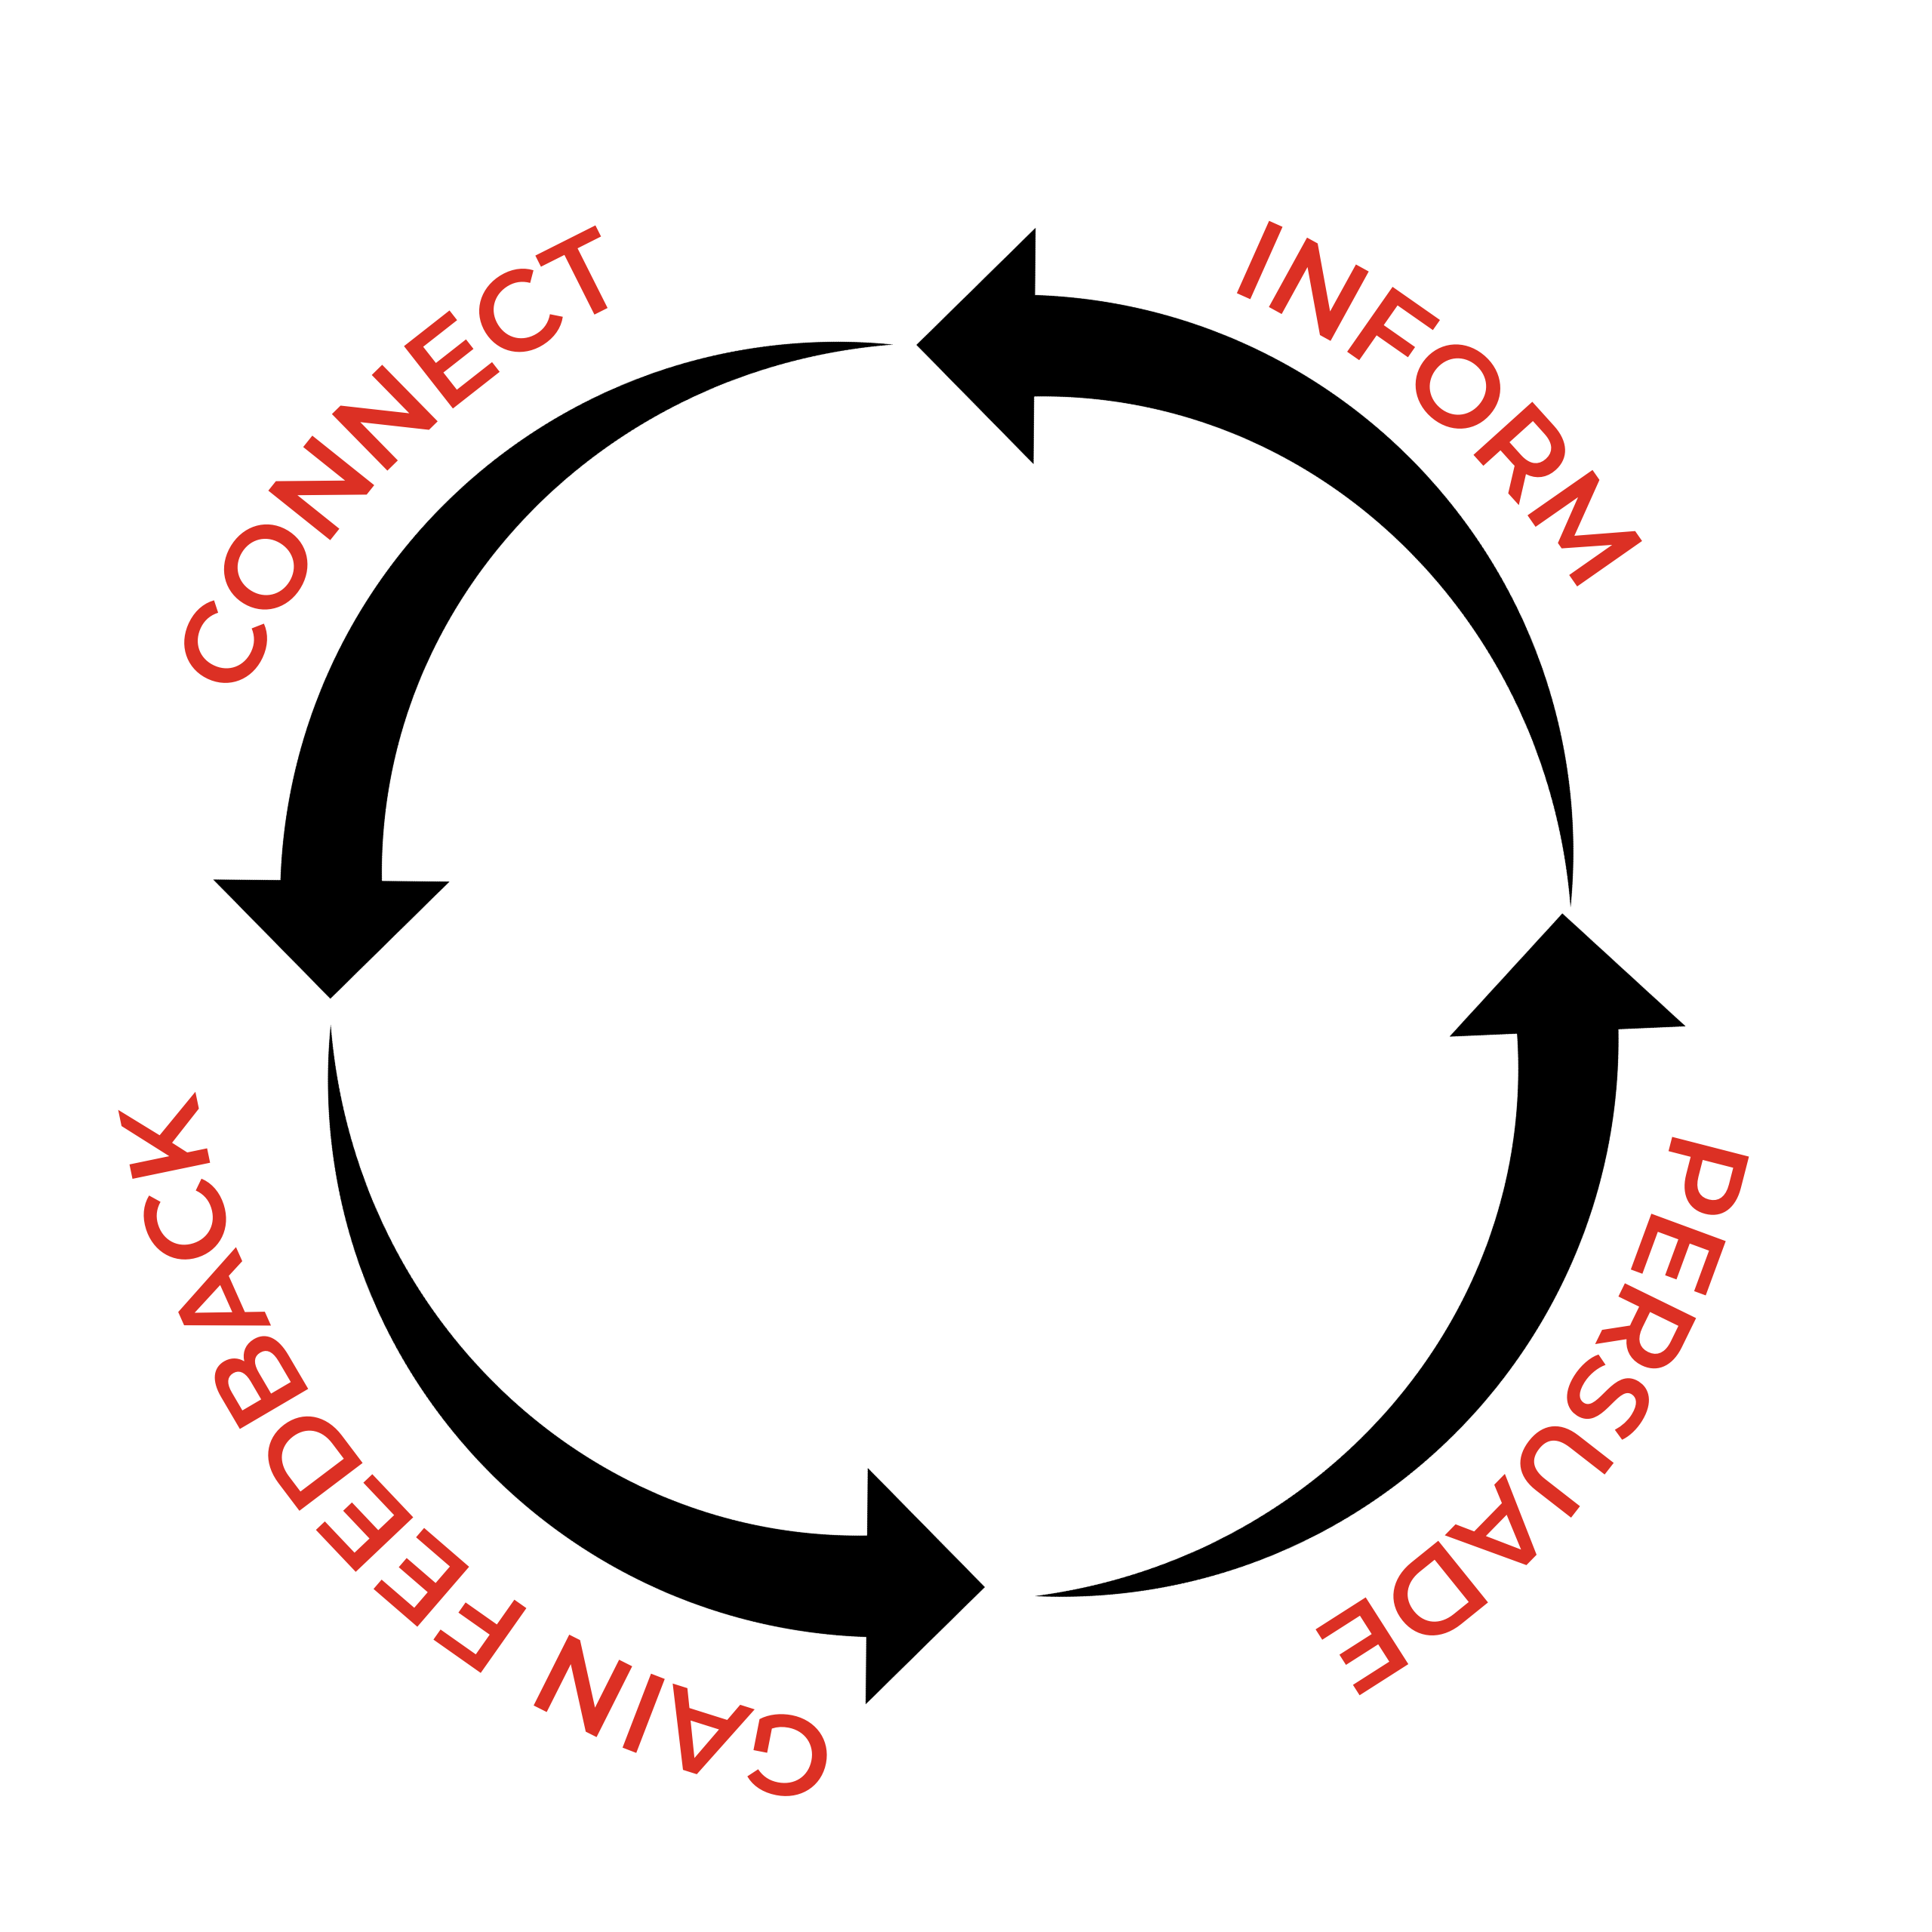
BUILD TRUST

Slide 20
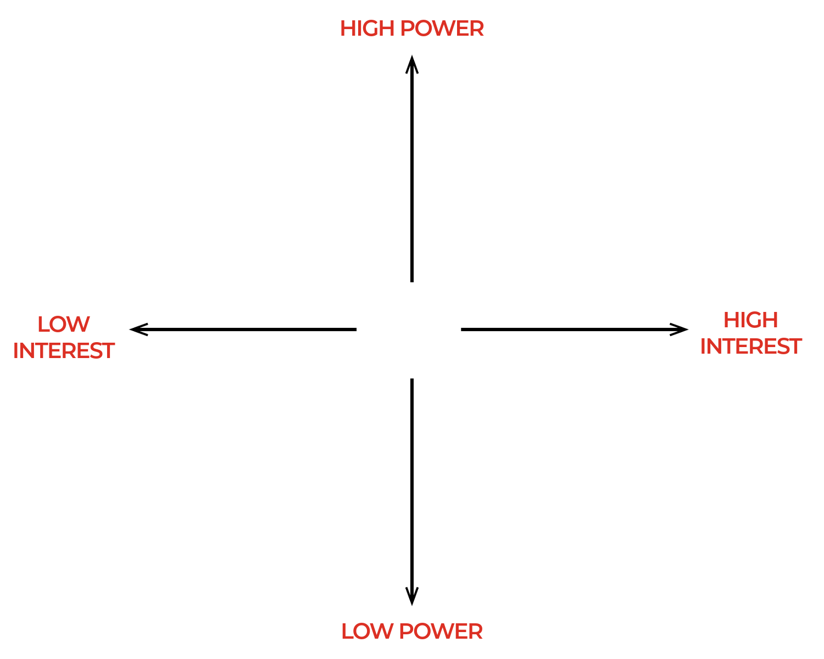
STAKEHOLDERS

Slide 21
ACTIVE
LISTENING
If people do not feel listened to
they will stop sharing.
listened

Slide 22
TAKE AWAYS
SO FAR

Slide 23
SESSION 6

Slide 24
INDUSTRY
TRENDS

Slide 25


ARTIFICIAL
INTELLIGENCE

Slide 26





ARTIFICIAL
INTELLIGENCE
CS Response
Smart Marketing
Smart Reservations
Dynamic Pricing
In Room Assistants

Slide 27
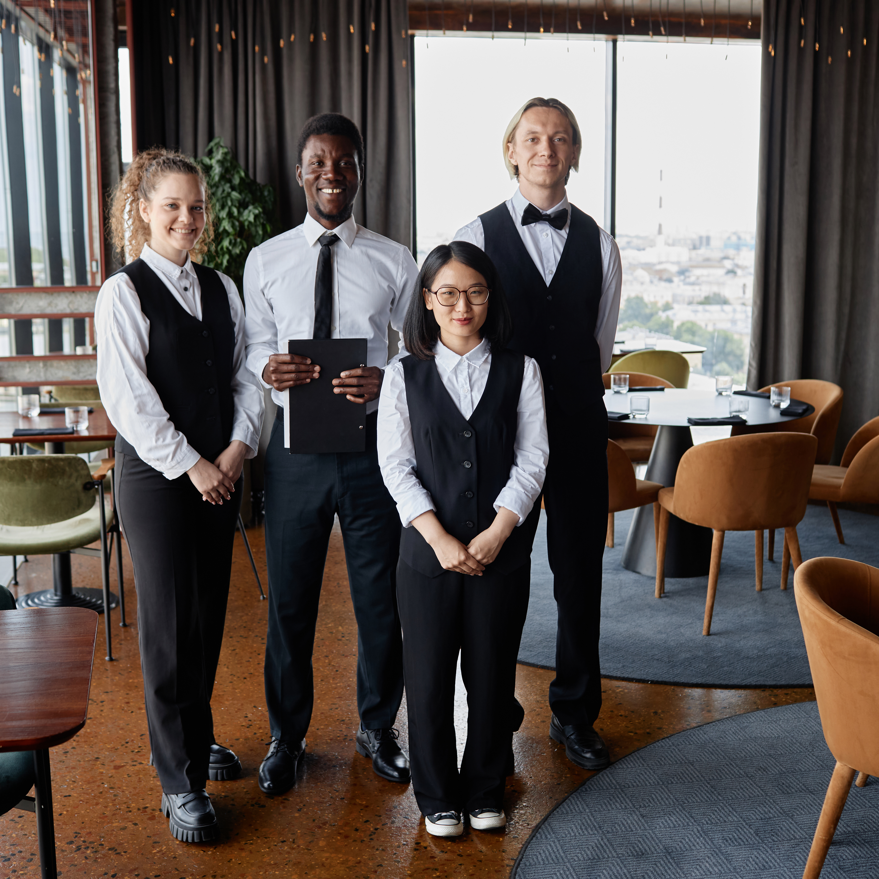
LABOUR
SHORTAGES

Slide 28

HYBRID
SPACES

Slide 29
EXPERIENCE
VS POSSESSIONS
Notes:
The Stick of Rock
The Celebrity Meeting vs Keanu Reeves

Slide 30
MODELS OF
CHANGE
Lewin’s Change Model
McKinsey 7-S
ADKAR
Bridges Transition Model
Kublar-Ross Framework
The Satir Model

Slide 31






KOTTER’S
8 STEPS
Create Urgency
Form Coalitions
Create a Vision
Communicate
Remove Obstacles
Create Quick Wins
Build on Change
Anchor in Culture

Slide 32
WHAT’S YOUR
STYLE

Slide 33










REMEMBER
THESE BRANDS
33
thecultureguy.co.uk

Slide 34
REMEMBER
THESE BRANDS
34
thecultureguy.co.uk

Slide 35
YOUR
STORIES

Slide 36
RESILIENCE
Tough times never last,
tough people do.
times
people
Robert H. Schuller

Slide 37
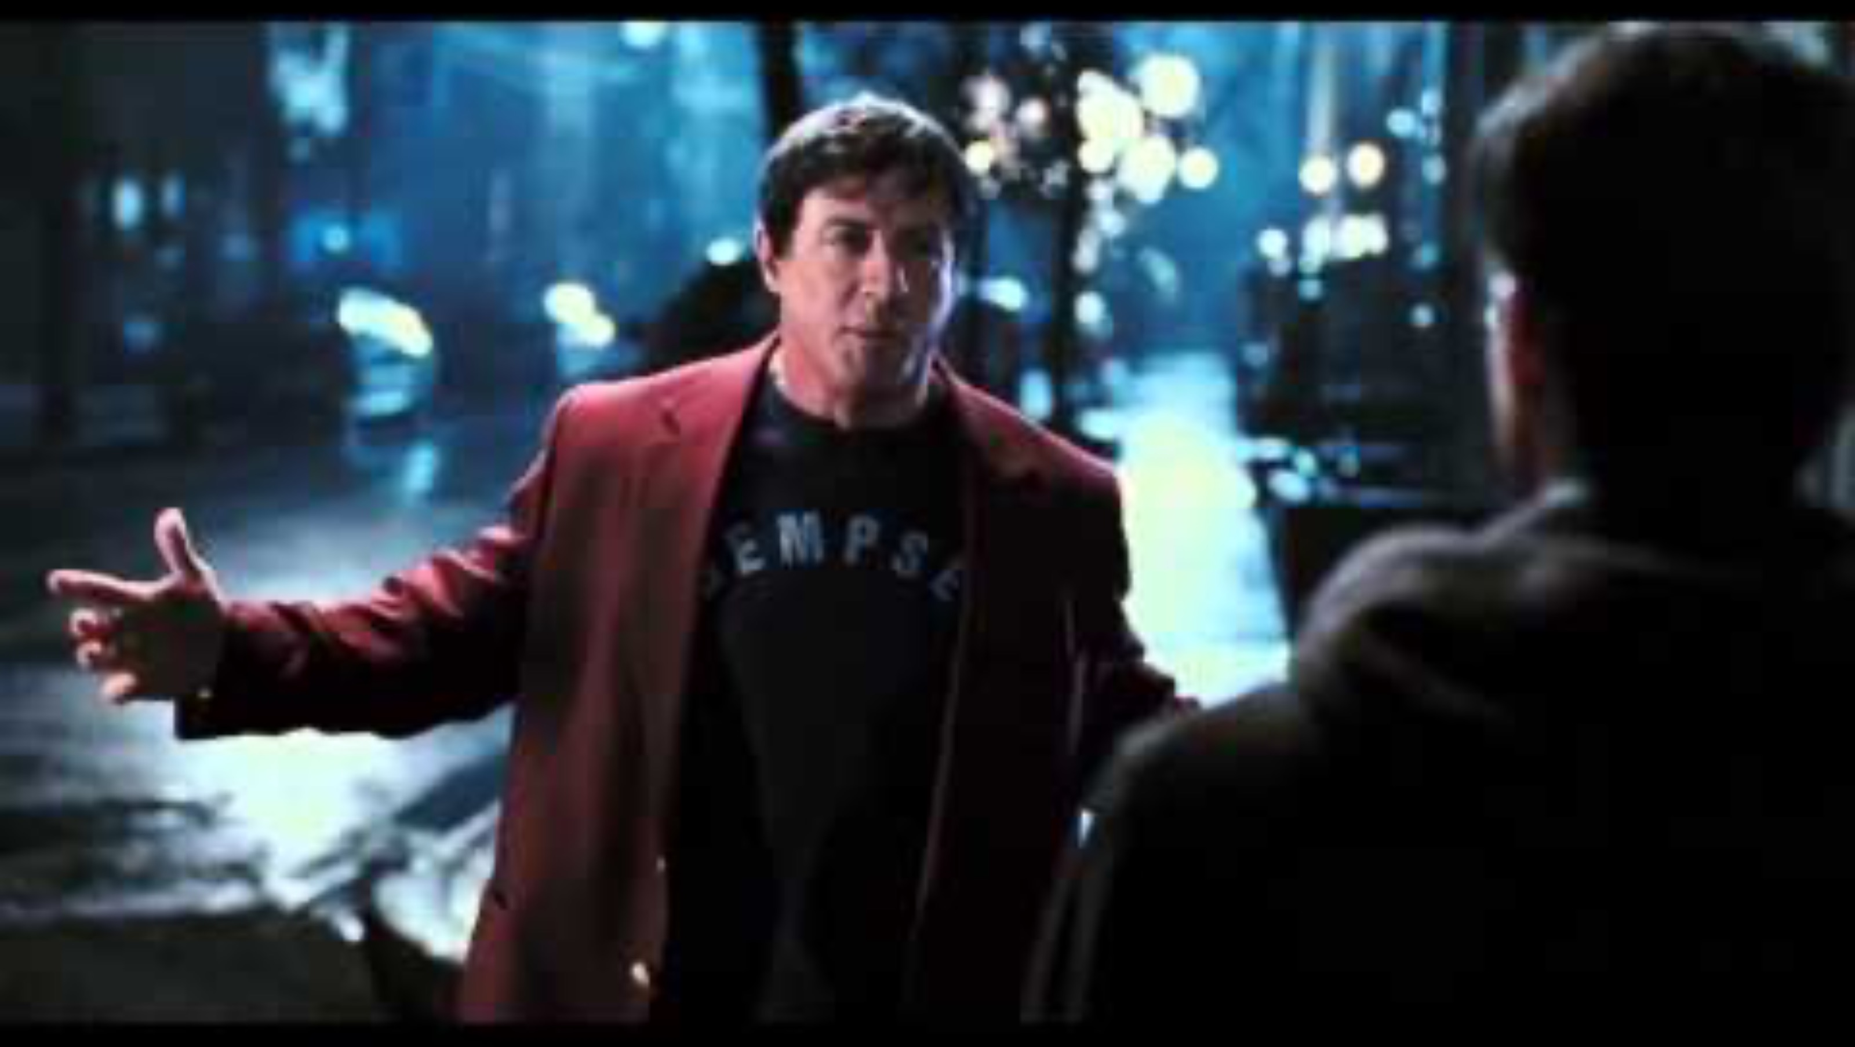

Slide 38
RESILIENCE
the capacity to withstand or to recover quickly from difficulties; toughness.
withstand
recover

Slide 39
WHAT’S YOUR
STYLE

Slide 40
7 PRACTICES

Slide 41

7 PRACTICES
1. Remember the destination.

Slide 42

7 PRACTICES
2. Only compare to yesterday.

Slide 43

7 PRACTICES
3. Hold each other
to account.

Slide 44

7 PRACTICES
4. Celebrate forward motion.

Slide 45

7 PRACTICES
5. Trust the process.

Slide 46

7 PRACTICES
6. Expect plateaus.

Slide 47

7 PRACTICES
7. Have each
other’s back.

Slide 48
YOUR
STORIES

Slide 49
SELF-CARE
WELLBEING

Slide 50
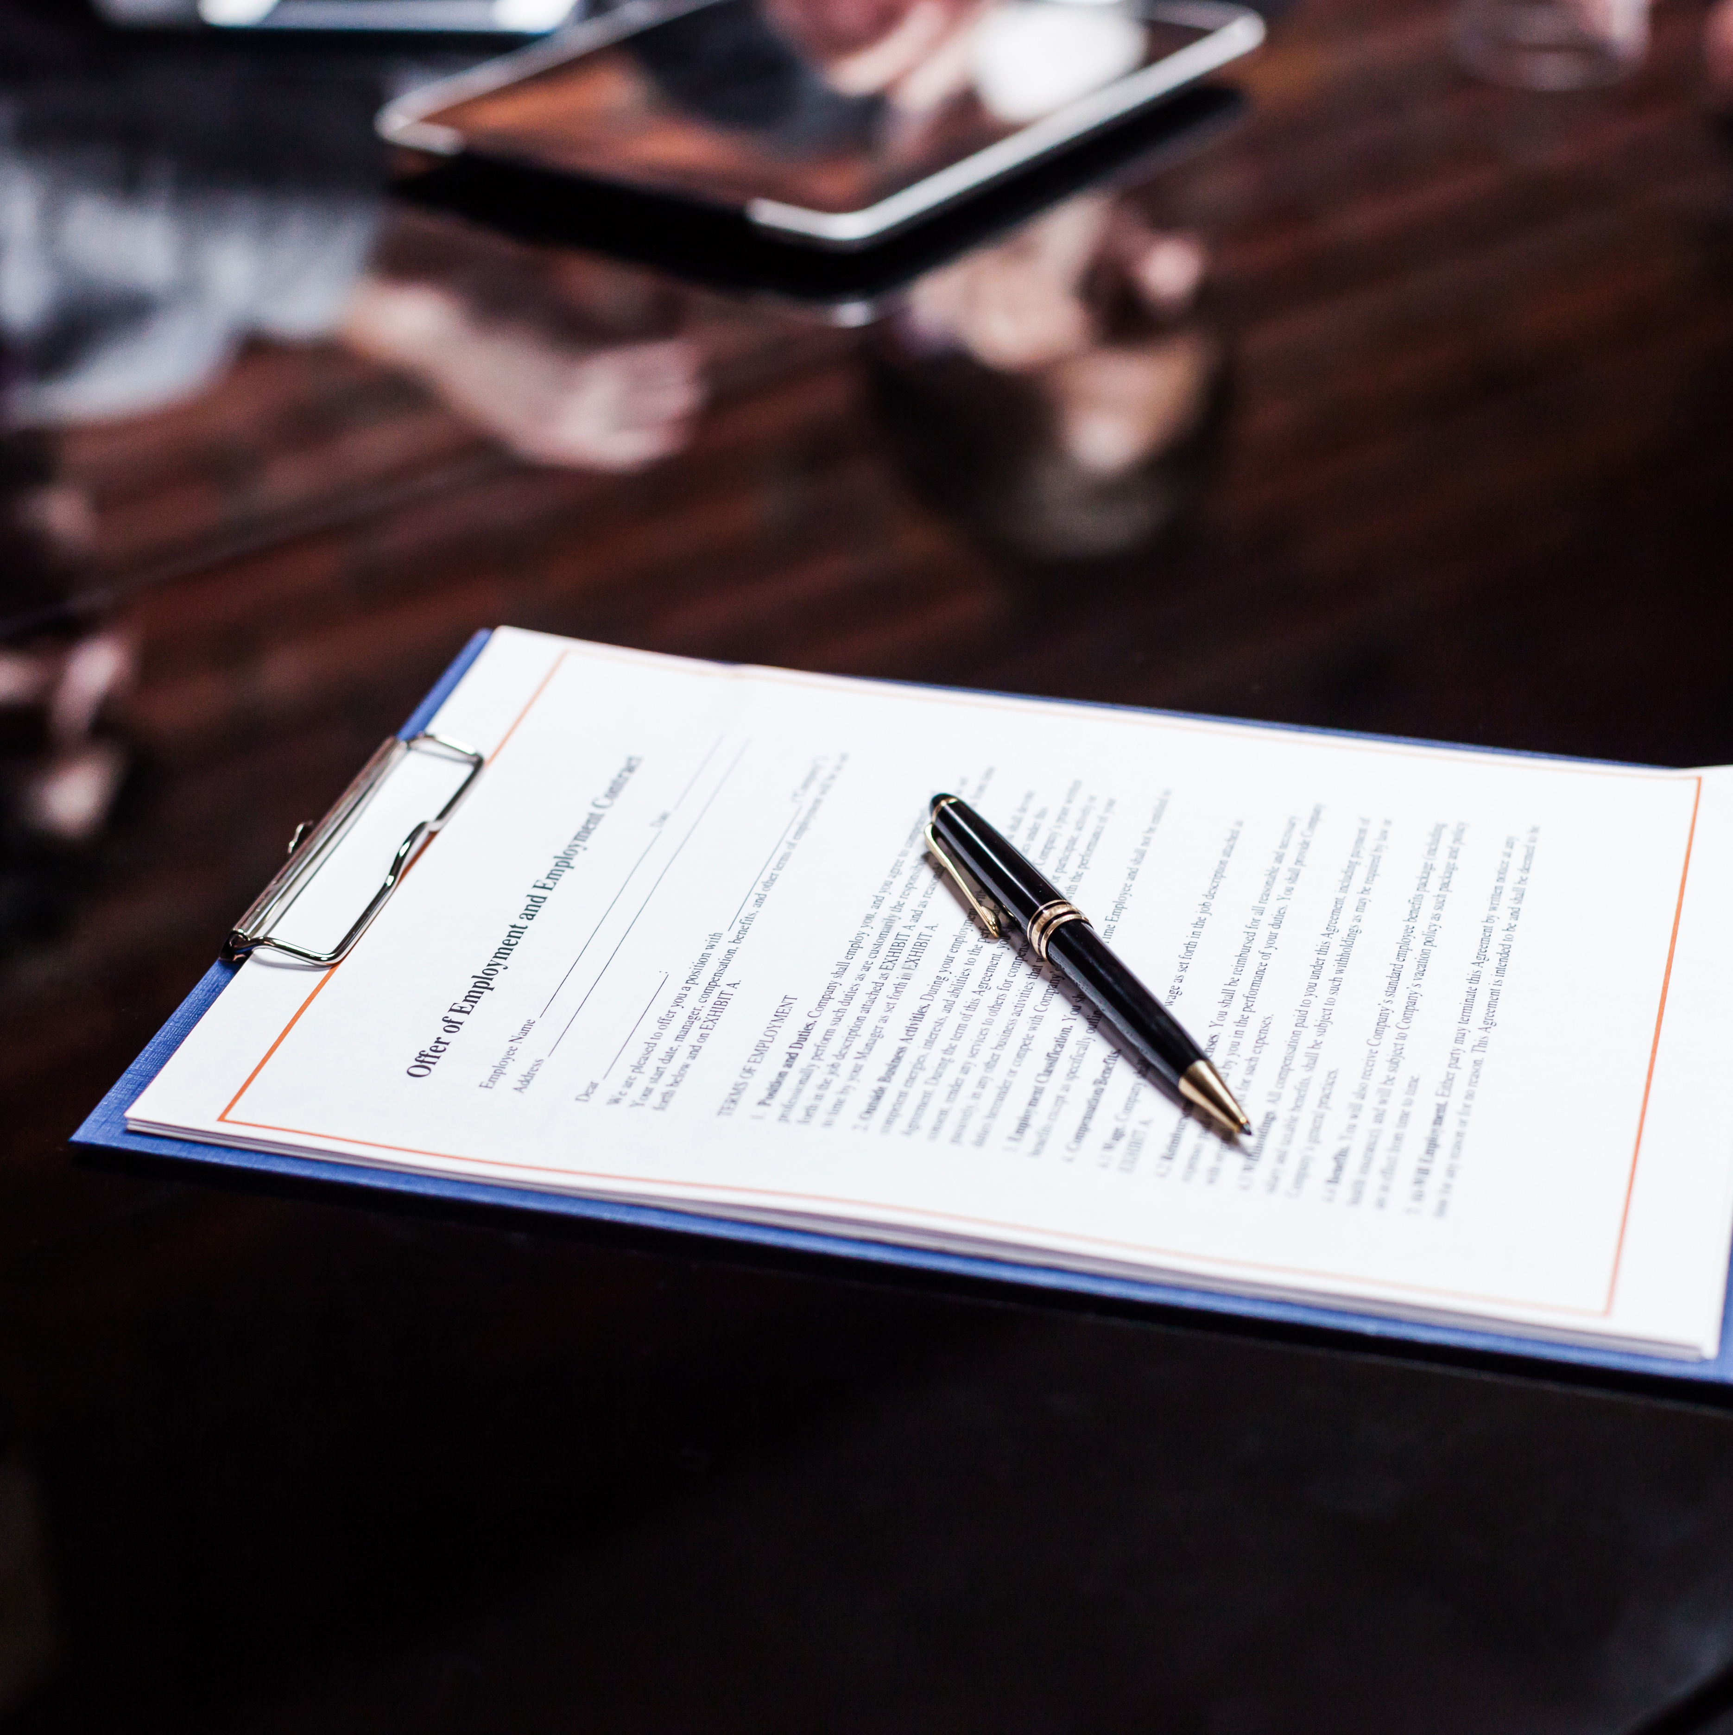
THE PLEDGE

Slide 51
WHAT’S NEXT

Slide 52
SIX SESSIONS
Understanding Your Style
Egoless leadership
Motivating
High Performers
Effective Communication
Leading Innovation
Leading through change
Notes:
Session 1: Understanding how you (as an individual) lead and the implicit biases that affect success.
Session 2: What is egoless/emotionally intelligent leadership?
Session 3: Inspiring and motivating high performing teams in a fast-paced environment where decision making is required at all levels.
Session 4: Effective communication and influential leadership.
Session 5: Leading guest experience excellence and innovation.
Session 6: Leading through change and adversity and how to use them as a secret weapon.

Slide 53
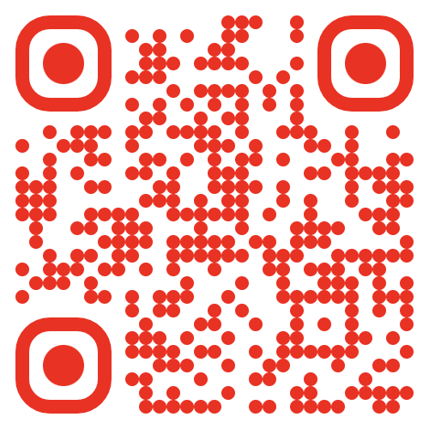
THANK YOU!
ANY QUESTIONS?
thecultureguy.co.uk/bpl

