Slide 1



UNDERSTANDING MY
LEADERSHIP STYLE

Slide 2






SIX SESSIONS
Understanding Your Style
Egoless leadership
Motivating
High Performers
Effective Communication
Leading Innovation
Leading through change

Slide 3
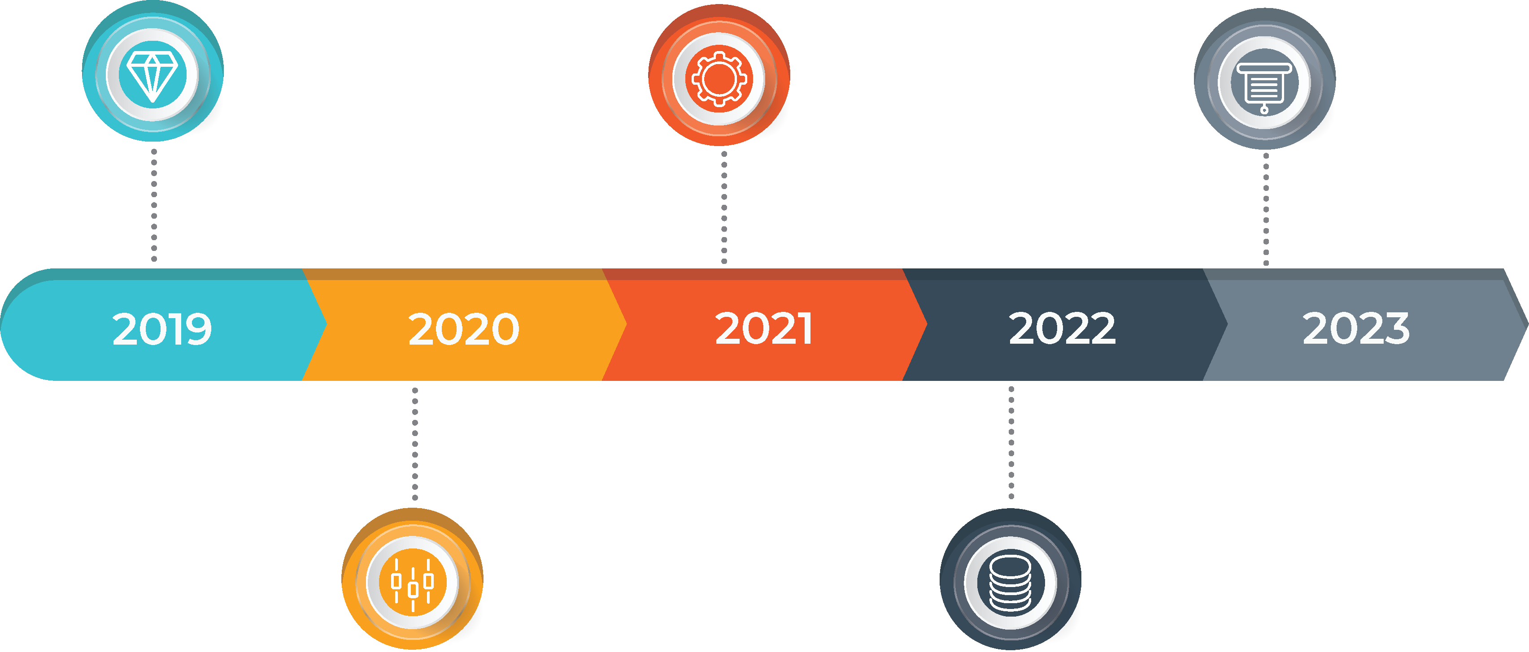
TIMELINE

Slide 4




MODES OF
LEADERSHIP
Authoritative
Democratic
Facilitative
Situational

Slide 5
SCENARIO
ONE
An employee in a long meeting asks a tough question: they zoom out and question the value of the project you're all focused on. "How did we get here? What made us decide to do this in the first place?” As you look round the room you realise other people are wondering the same thing.

Slide 6
SCENARIO
TWO
You have an employee that has been employed for about 18 months, they have been an above average employee, learning fast, doing their work well, being proactive. Recently, their work has slipped. You notice they've been spending more time with the old guard, who have been around for decades and are just cruising along on auto pilot to retirement.

Slide 7
SCENARIO
THREE
You have someone on your team in a role you've never done yourself. You're not familiar with all the nuance of what they do, nor their keys to success.

Slide 8

SCENARIO
FOUR
You’re deciding who on your team is the best candidate for a promotion. Who you choose will change your team dynamics from current roles to what gets back filled, what you signal you’re rewarding, to who you’ll work more closely with going forward.

Slide 9
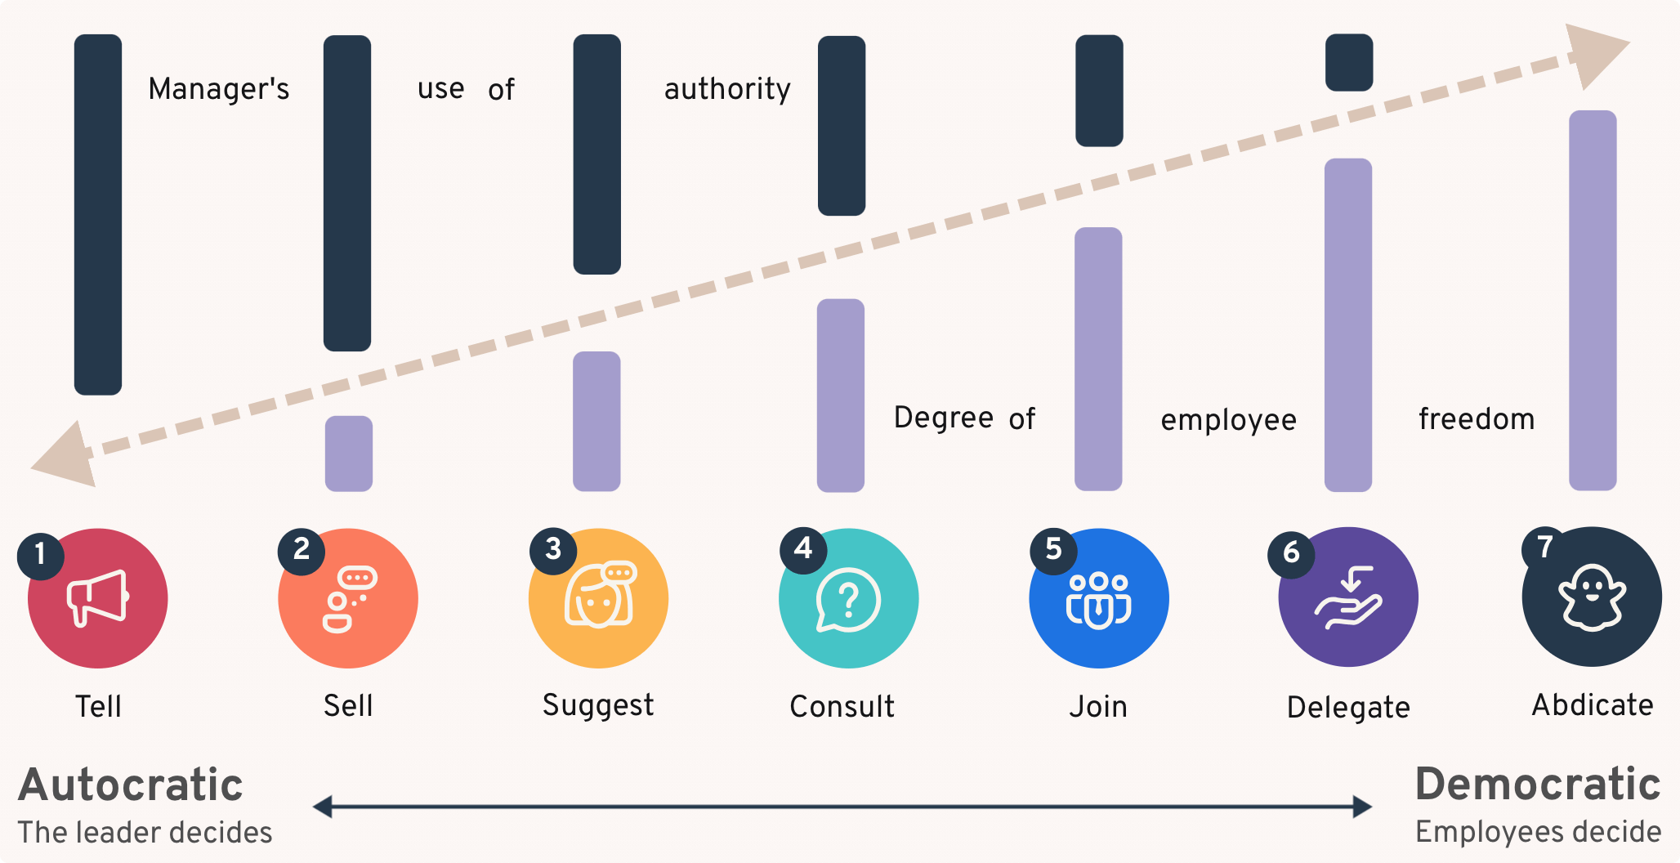
MODELS OF
LEADERSHIP
Tannenbaum-Schmidt Continuum

Slide 10
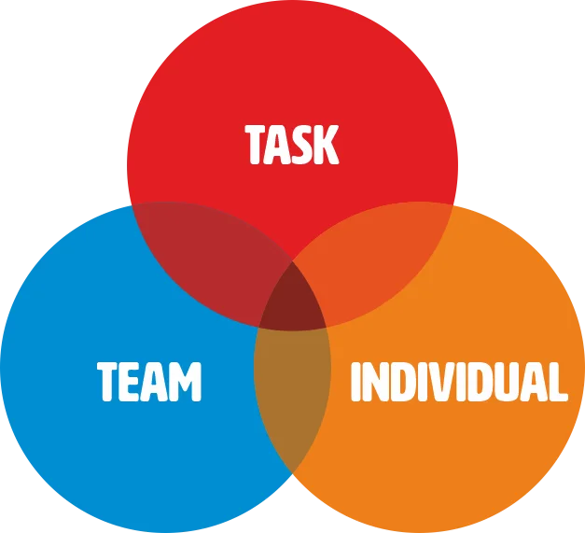
MODELS OF
LEADERSHIP
Action-centred Leadership

Slide 11
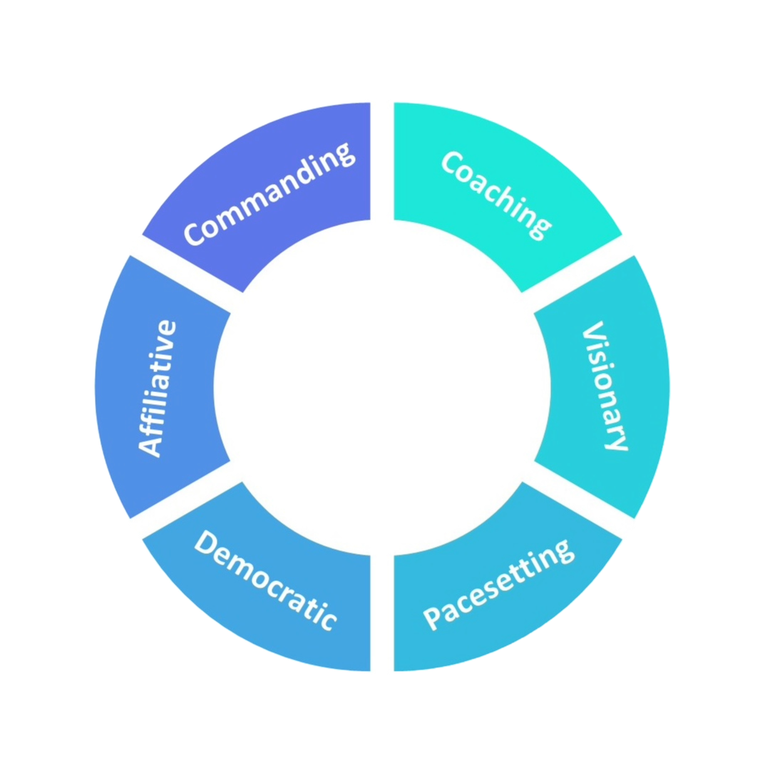
MODELS OF
LEADERSHIP
Goleman
Six Styles

Slide 12
THE FUTURE
OF LEADERSHIP
“Leadership is your ability to influence others to do something that has an impact ,
and them feel grateful and
fulfilled for having done it.”

Slide 13
YOUR STYLE

Slide 14
IMPLICIT
BIAS

Slide 15
IMPLICIT
BIAS
“To make life easier, our brains make quick judgements of people and situations around us, often without realising it.”

Slide 16

8 PRINCIPLES
01. Be aware of biases.

Slide 17

8 PRINCIPLES
02. Make considered decisions.

Slide 18

8 PRINCIPLES
03. Monitor you & your team's behaviour.

Slide 19

8 PRINCIPLES
04. Widen your social circle.

Slide 20

8 PRINCIPLES
05. Set ground rules for behaviour.

Slide 21

8 PRINCIPLES
06. Avoid assumptions or gut instinct.

Slide 22

8 PRINCIPLES
07. Use process to avoid stereotyping.

Slide 23

8 PRINCIPLES
08. Speak out.

Slide 24

8 PRINCIPLES
09. Apologise when you’re wrong.

Slide 25
YOUR
PLAN

Slide 26
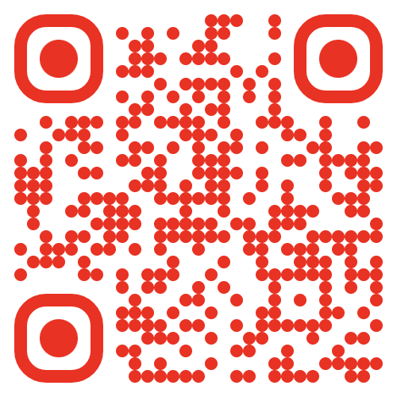
THANK YOU!
ANY QUESTIONS?
thecultureguy.co.uk/bpl

