Slide 1
COMMUNICATION
& INFLUENCE

Slide 2
SIX SESSIONS
Understanding Your Style
Egoless leadership
Motivating High Performers
Leading Innovation
Leading through change
Effective Communication

Slide 3
BACK IN
THE HAT

Slide 4
BACK IN
THE HAT
Round 1: Describe the word using any words except the word on the paper.
Round 2: Describe the word using one word only.
Round 3: Act out the word using no words

Slide 5
WHY DO WE
COMMUNICATE?

Slide 6
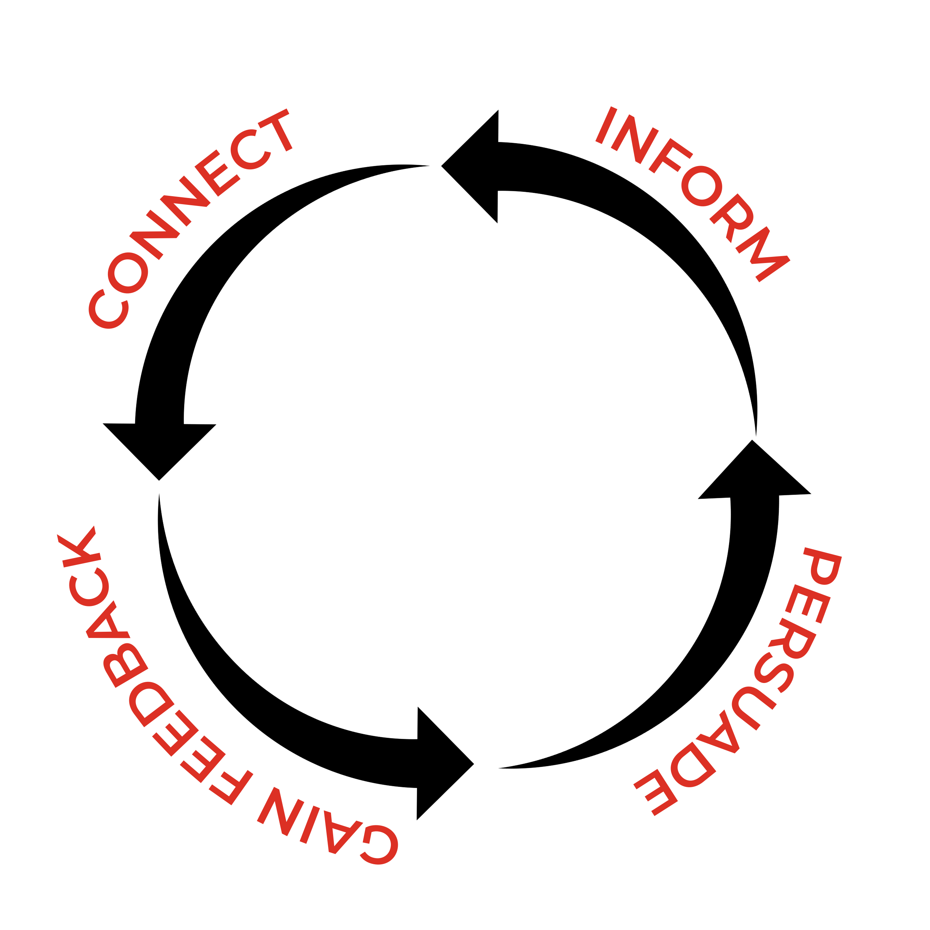
BUILD TRUST

Slide 7
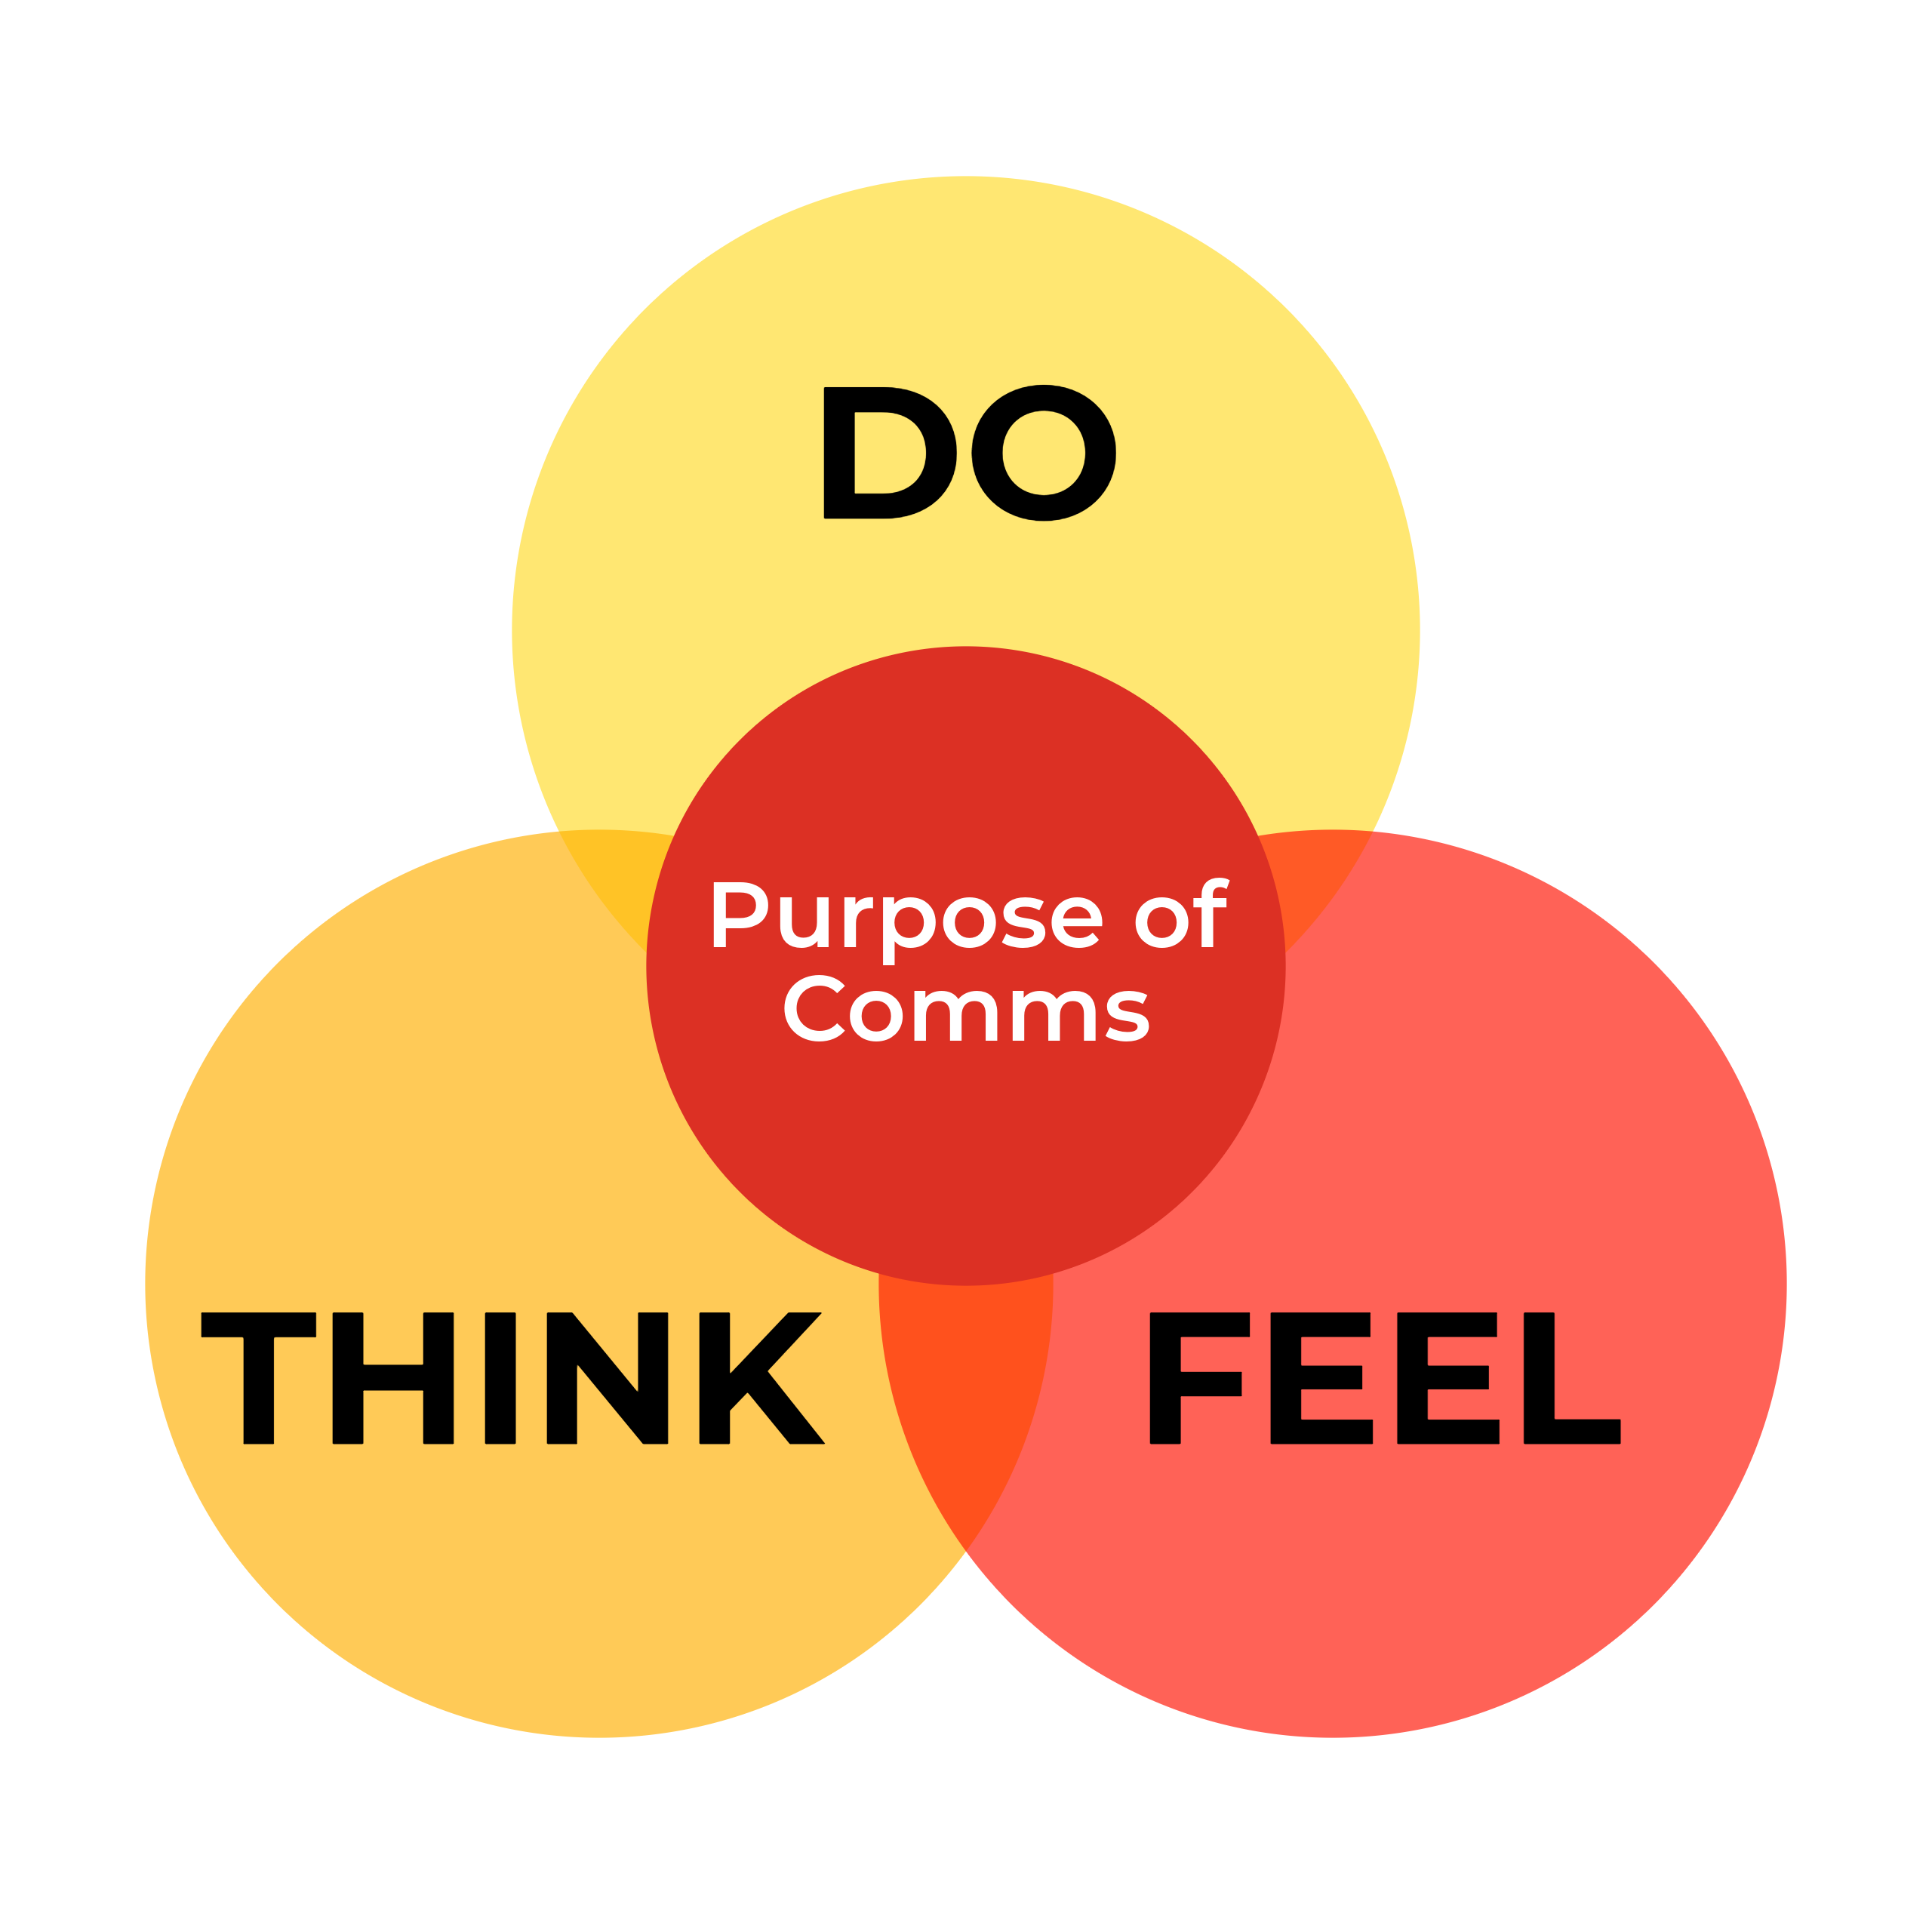

Slide 8
Think of a time when you wanted to connect , inform, persuade or gain feedback from someone.
What did you make them think?
What did they do? How did they feel?
connect
persuade

Slide 9
STAKEHOLDERS

Slide 10
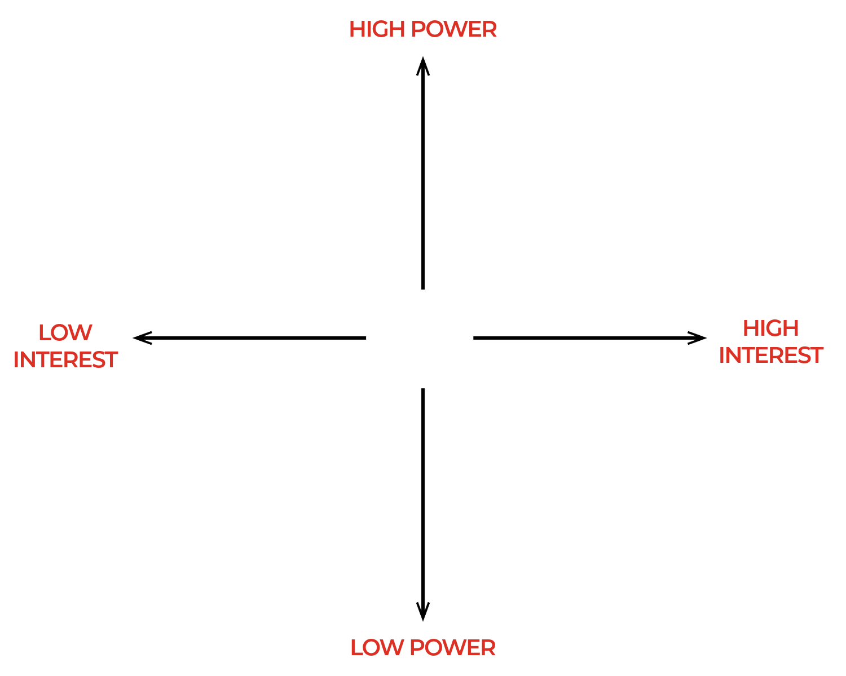
STAKEHOLDERS

Slide 11
STAKEHOLDERS
You have a hotel wide power cut.

Slide 12
STAKEHOLDERS
You are planning a
team restructure.

Slide 13
STAKEHOLDERS
Preparing for a sudden influx of guests for a state funeral.

Slide 14
STAKEHOLDERS
A guest claims to have food poisoning from Sette.

Slide 15
THE QUESTION

Slide 16
ACTIVE
LISTENING
If people do not feel listened to
they will stop sharing.
listened

Slide 17
ACTIVE
LISTENING
Notes:
The Stick of Rock
The Celebrity Meeting vs Keanu Reeves

Slide 18
ACTIVE
LISTENING
Cognitive: Pay attention to all the information, both explicit and implicit,
that you are receiving from the other person, comprehending,
and integrating that information
Emotional: Stay calm and compassionate during the conversation,
including managing any emotional reactions (annoyance, boredom)
you might experience
Behavioral: Conveying interest and comprehension verbally and nonverbally

Slide 19
STORYTELLING

Slide 20
STORYTELLING
Go back to the scenarios and think about how you could use a story to persuade, inform, connect with your audience or seek feedback.
persuade
connect

Slide 21
COMMUNICATION
Shape the message
Listen more
Know your audience

Slide 22
SIX SESSIONS
Understanding Your Style
Egoless leadership
Motivating High Performers
Effective Communication
Leading Innovation
Leading through change

Slide 23
THANK YOU!
ANY QUESTIONS?
thecultureguy.co.uk/bpl

