Slide 1
EXPERIENCE AND
INNOVATION

Slide 2
SIX SESSIONS
Understanding Your Style
Egoless leadership
Motivating High Performers
Effective Communication
Leading through change
Leading Innovation

Slide 3
A HOUSE BRICK

Slide 4
CH..CH..CHANGES?

Slide 5
TOMORROW’S
WORLD

Slide 6
INNOVATION
losing
Stop guests losing their keys.

Slide 7
INNOVATION
check-in
Improve the check-in process?

Slide 8
INNOVATION
How do we anticipate
needs ?
needs

Slide 9
INNOVATION
Reduce waste and
environmental impact?
environmental

Slide 10
INNOVATION
room experience
Improve the room experience
when no one is around.

Slide 11
I CAN’T BE
BOTHERED

Slide 12
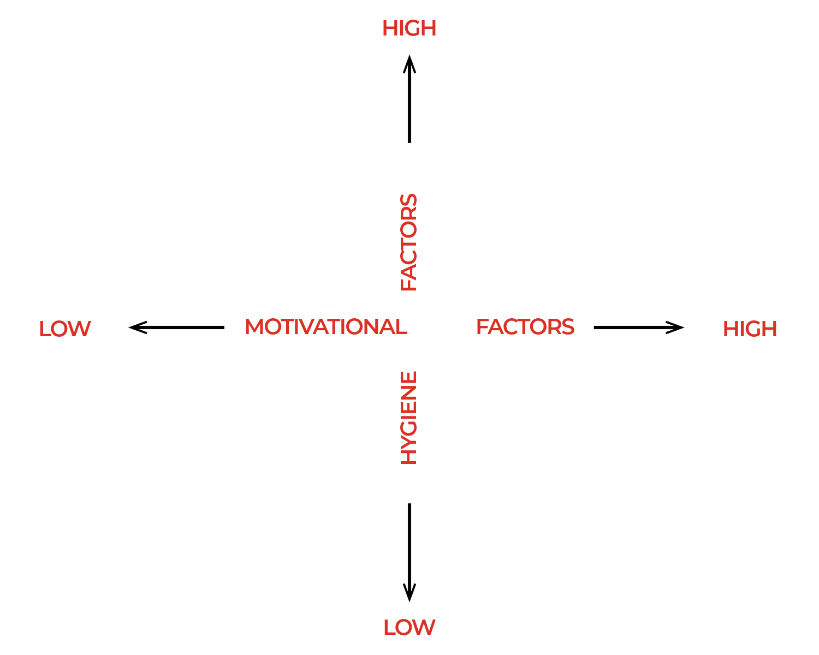

Slide 13
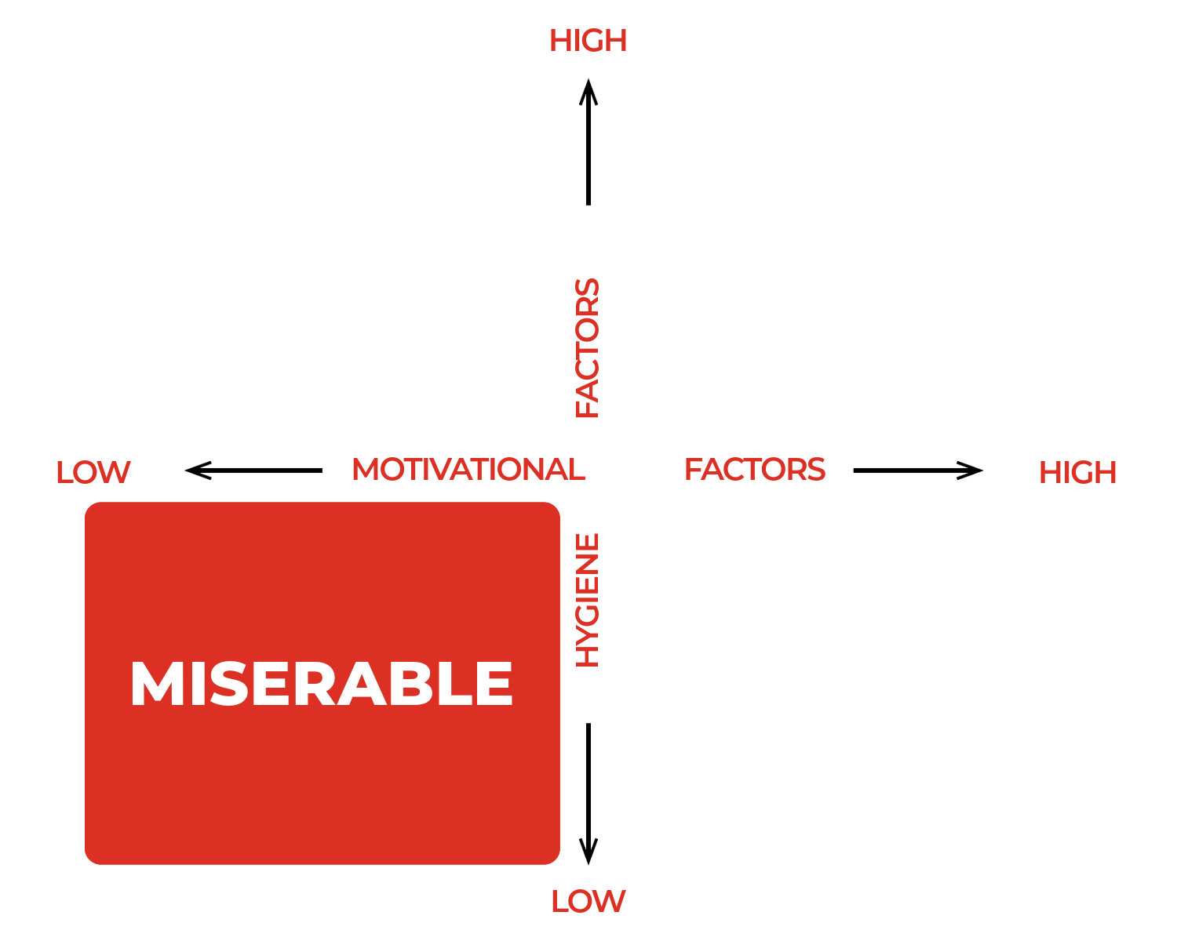

Slide 14
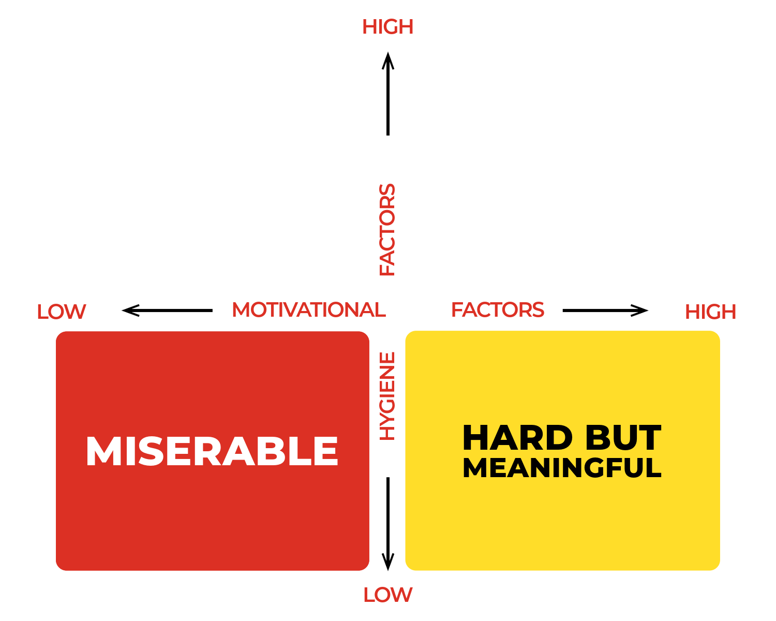

Slide 15
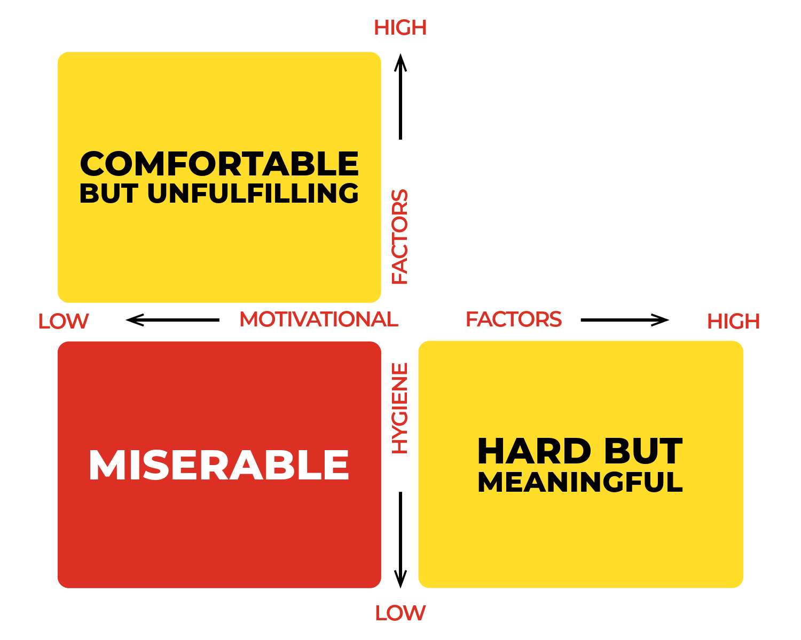

Slide 16
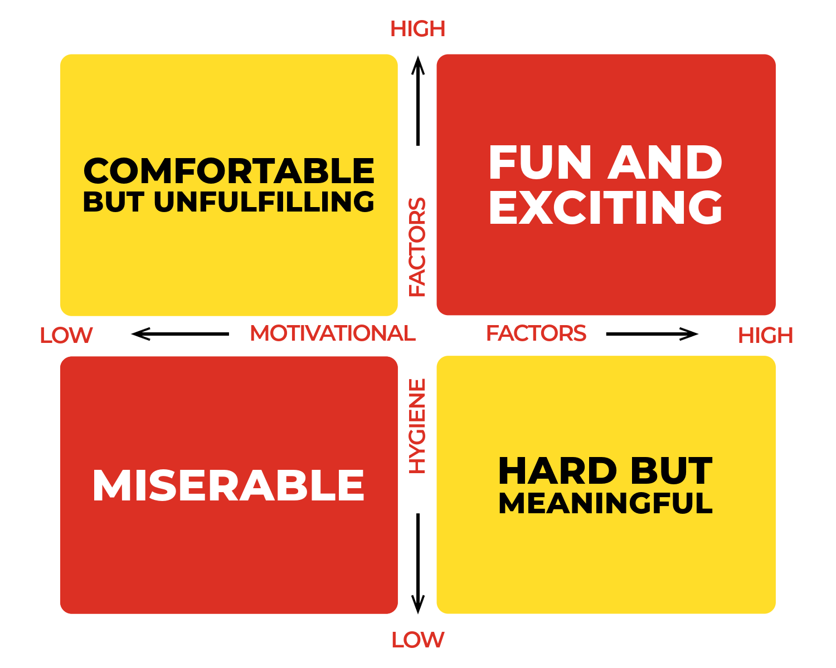

Slide 17
MOTIVATION
Achievement
Recognition
The Work Itself
Responsibility
Advancement
Growth

Slide 18
HYGIENE
Bureaucracy
Relationships
Work Conditions
Status
Salary
Job Security

Slide 19
NINE LAWS OF
INNOVATION

Slide 20
NINE LAWS
Provide structure
not control.

Slide 21
NINE LAWS
02. Build trust avoid suspicion.

Slide 22
NINE LAWS
03. Be open not secretive.

Slide 23
NINE LAWS
04. Be flexible not rigid.

Slide 24
NINE LAWS
05. Be collaborative not competitive.

Slide 25
NINE LAWS
06. Make time not work.

Slide 26
NINE LAWS
07. Be offensive not defensive.

Slide 27
NINE LAWS
08. Be humble not arrogant.

Slide 28
NINE LAWS
09. Aim for progress not perfection.

Slide 29
WHERE DID IT
GO WRONG

Slide 30
GROWTH
MINDSET

Slide 31
KEY
COMPONENTS
Learning
Effort
Challenge
Criticism

Slide 32
GROWTH
MINDSET
01. Encouraging a culture of continuous learning and improvement.

Slide 33
GROWTH
MINDSET
02. Acknowledging and celebrating efforts and progress.

Slide 34
GROWTH
MINDSET
03. Fostering a positive and supportive environment for taking risks.

Slide 35
GROWTH
MINDSET
04. Positive self talk.

Slide 36
GROWTH
MINDSET
05. Embrace challenges.

Slide 37
GROWTH
MINDSET
06. You win or you learn.

Slide 38
GROWTH
MINDSET
07. Watch your language.

Slide 39
GROWTH
MINDSET
08. Practise self reflection.

Slide 40
SIX SESSIONS
Understanding Your Style
Egoless leadership
Motivating High Performers
Effective Communication
Leading Innovation
Leading through change

Slide 41
THANK YOU!
ANY QUESTIONS?
thecultureguy.co.uk/bpl

