Slide 1
Collective Genius.

Slide 2
Define Business.

Slide 3
Social revolution.

Slide 4
9/10 millennials.
TalentCulture 2023 (https://whattobecome.com/blog/millennials-in-the-workplace/)

Slide 5
Relationships with purpose.

Slide 6
Find passionate
people to journey with,
give them something
to get excited about
and cut them loose
to be brilliant.

Slide 7
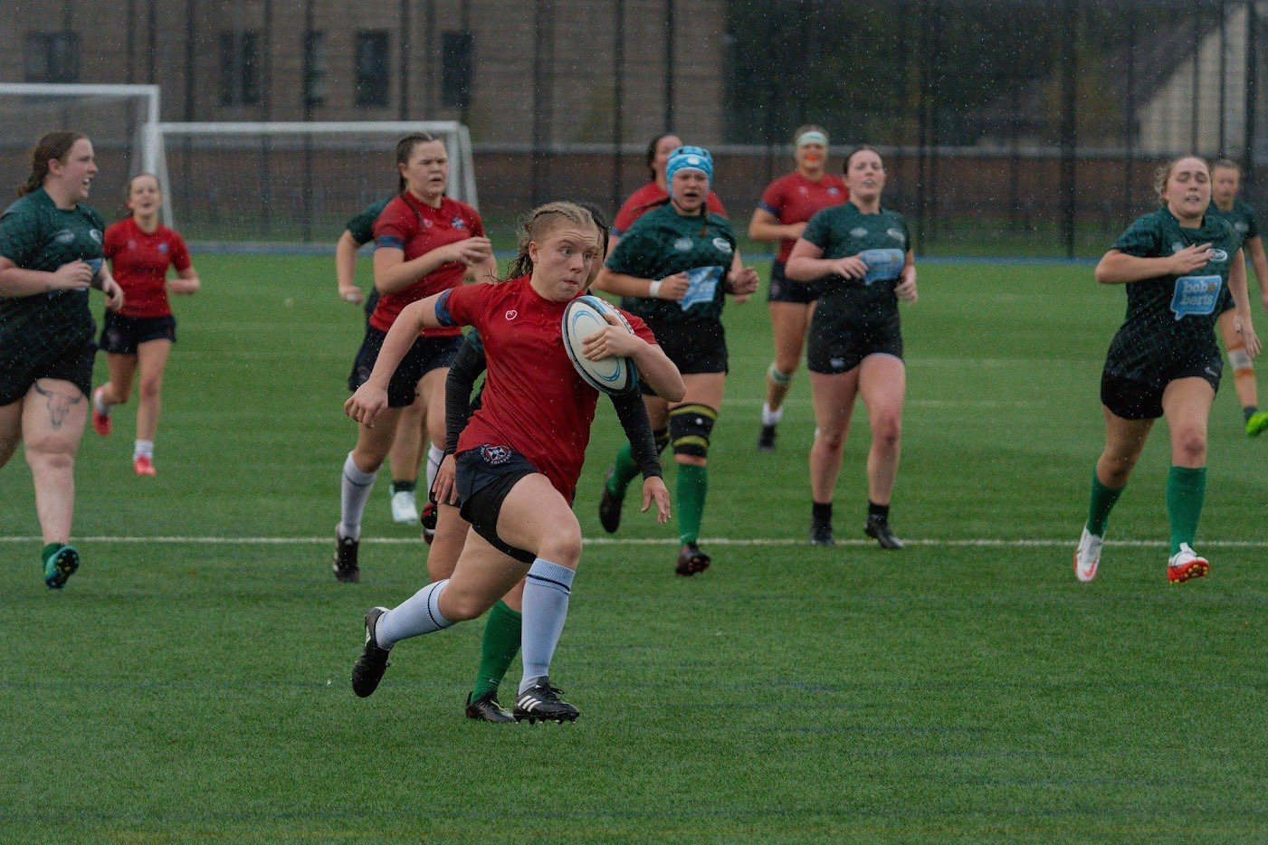
My team.

Slide 8
Revenue up.
Productivity up.
Staff turnover down.
Same holiday taken.
?

Slide 9
Stand up comedy.

Slide 10
Belonging.

Slide 11
Framework.
Trust.

Slide 13
The cause.

Slide 14
The players.

Slide 15
Framework goes here
Plan
Language
Structure
Systems

Slide 16
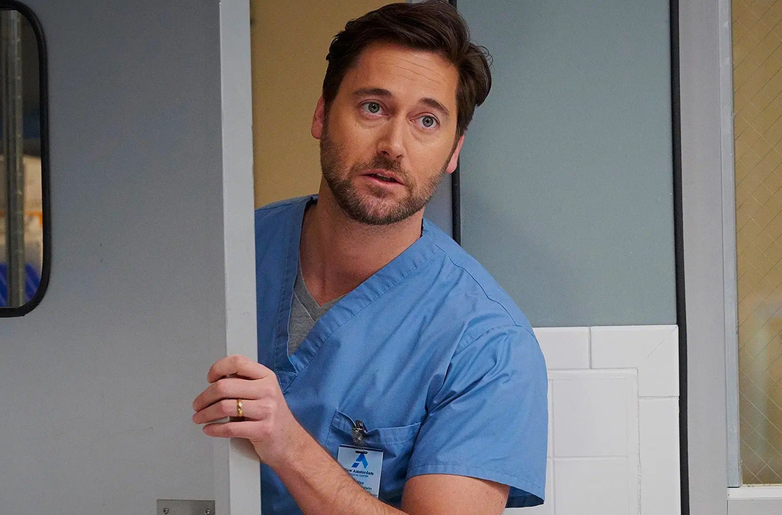
How are you doing?
How can I help?

Slide 17
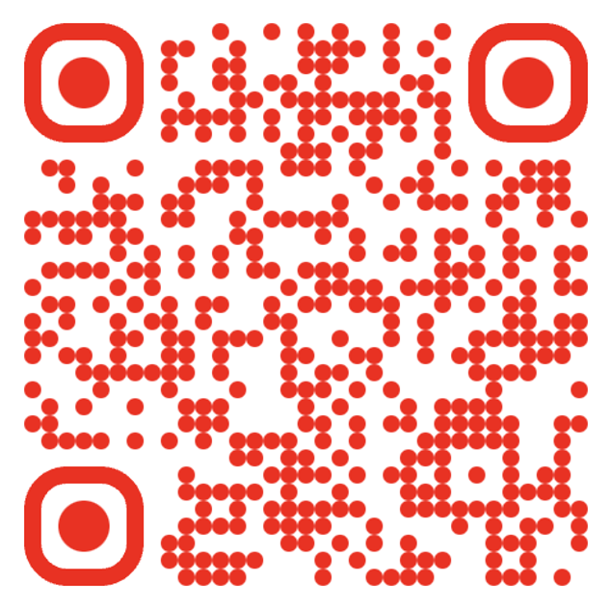
https://thecultureguy.co.uk/whitelabel

Slide 18
Questions.
(and maybe some answers)
The Culture Guy

